Slide 1

Instructions for installing Excel-On projects using ASP.NET MVC Framework

Slide 2
Step 1: Install the development environment
In this step, I will guide you to install Visual Studio software.
Download Link : https://visualstudio.microsoft.com/fr/

Slide 3
Step 2: Install the database management system
In this step, I will guide you to download and install Sql Server 2019 software.
Download Link :https://www.microsoft.com/en-us/sql-server/sql-server-downloads

Slide 4
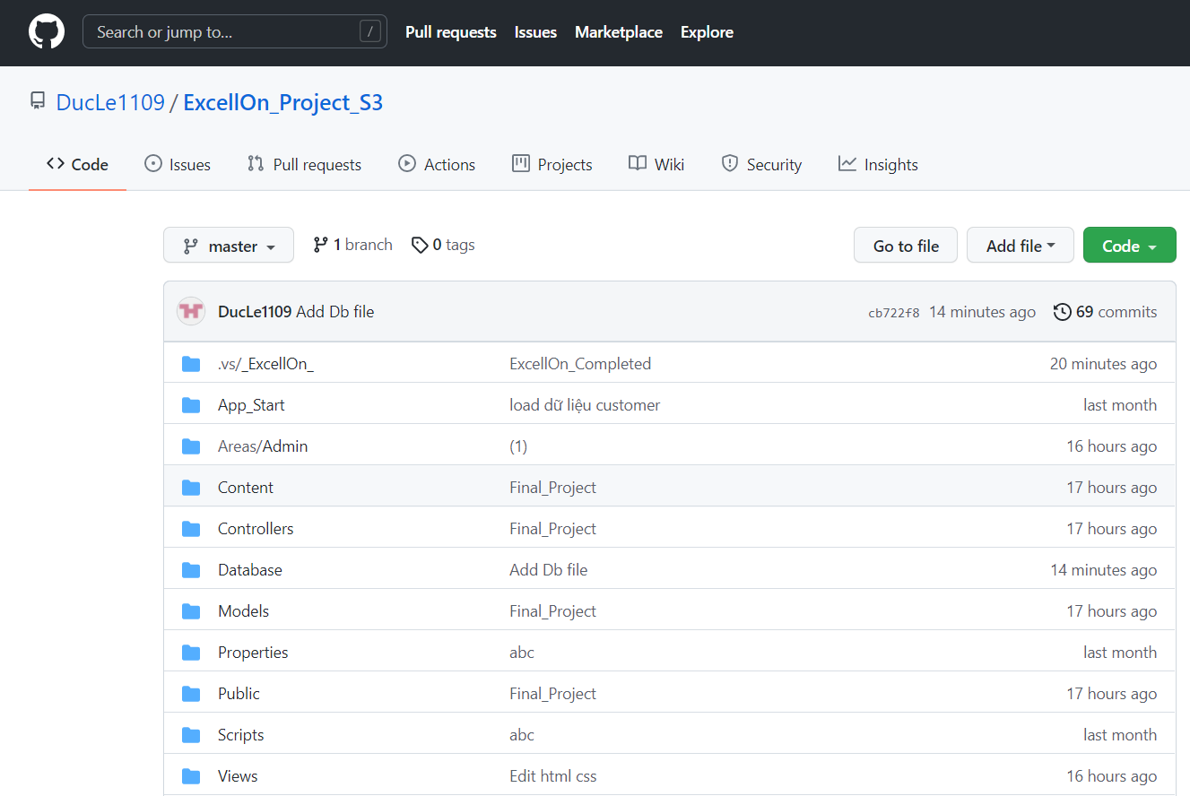
Step 3: Instructions to get the code from github
In this step, go to the following Git Link to download the code : https://github.com/DucLe1109/ExcellOn_Project_S3
This is the interface after you click on the link above

Slide 5
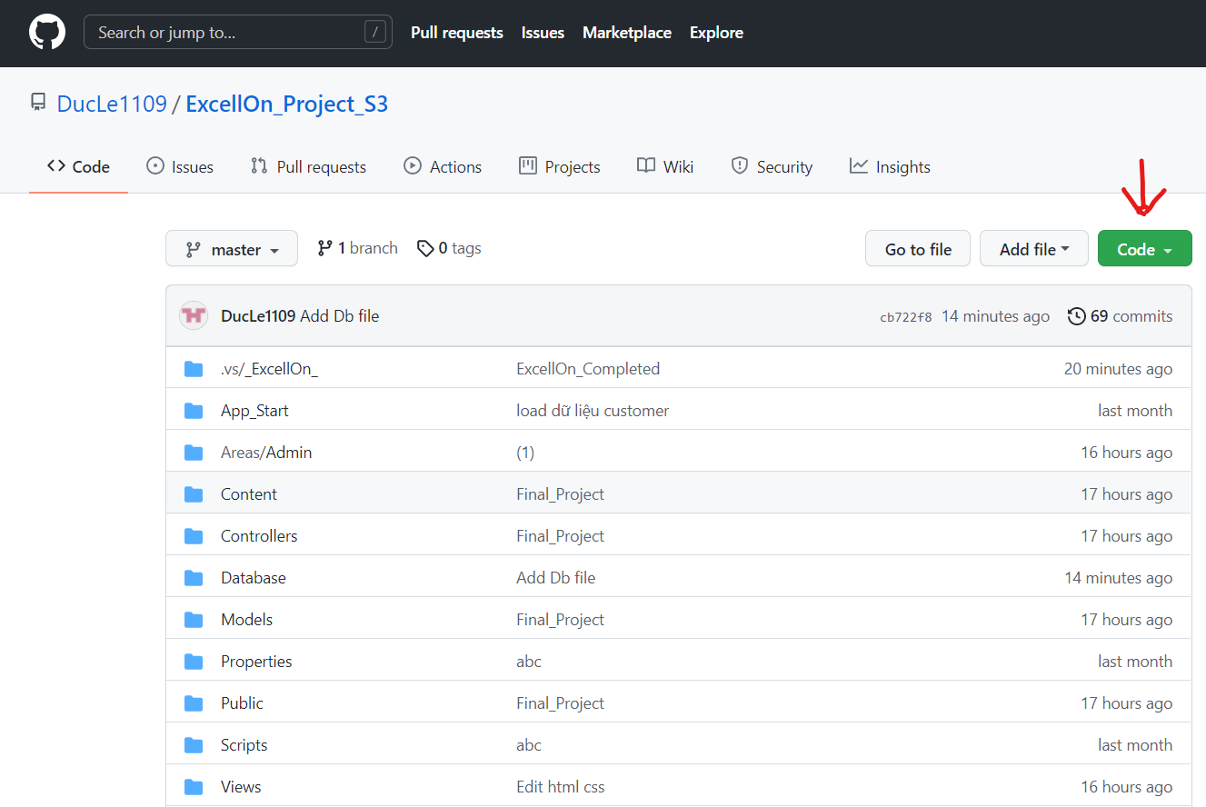
Next, click on the “Code” button on the right corner of the screen:

Slide 6
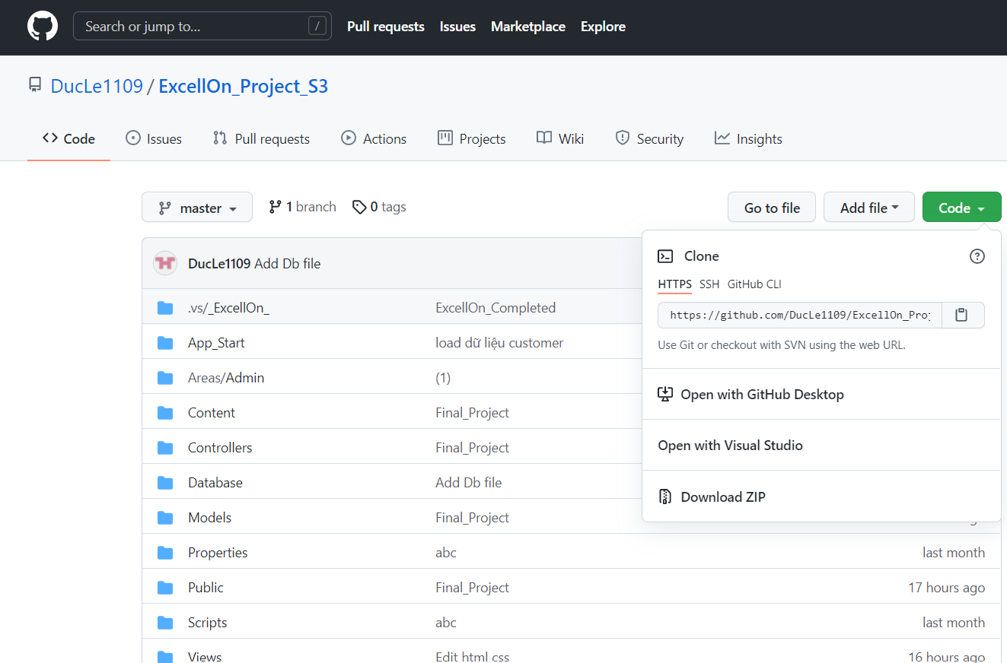
Next, you can choose 1 of 3 options that Github has suggested for you to download the code to your computer.

Slide 7
Step 4: Install Database
After downloading the source code successfully, go to the drive where the source code was downloaded and find the folder named "Database“.
Click on the folder “Database” we will see a file named “ExcellOn_Database.sql”.
Open the folder “ExcellOn_Database.sql” with SQL Server 2019 software (Download link in step 2).
Next, run the code to create a Database named: Excell-On.

Slide 8
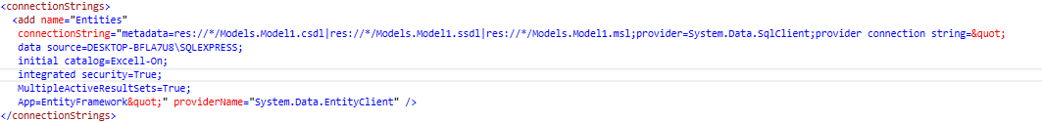
Step 5: Configure the file Web.config
You open the source code downloaded from Github with Visual Studio software
Go to the Web.config file to reconfigure the database connection string in the tab “connectionStrings”

Slide 9
In the above code, you will notice that there is a “ data source” entry.
In this "data source" section you change “DESKTOP-BFLA7U8\SQLEXPRESS“ into the Server Properties name in your computer (Sql Server 2019 => Copy Name => Paste “data source”. Then Rebuilt the project to run the application)
URL Client : https://localhost:*****/Home/Index
URL Admin Login: https://localhost:*****/AdminLogin
URL Staff Login: https://localhost:*****/StaffLogin
URL Customer Login: https://localhost:*****/CustomerLogin
WISH SUCCESS !

Slide 10
Step 6: Log in to the Excell-On system
Admin Account
UserName: huyduc
Password: huyduc123
CEO Account
UserName: CEO
Password: huyduc123
Manager Account
UserName: Manager
Password: huyduc123
HR-Department Account
UserName: nguyenkhanhlinh
Password: huyduc123
Service-Department Account UserName: tranvannam Password: huyduc123 Auditor-Department Account UserName: nguyenthanhhuyen Password: huyduc123 Traning-Department Account UserName: lemanhcuong Password: huyduc123

Slide 11
Step 6: Log in to the Excell-On
Staff Account
UserName: nv1,nv2,nv3,nv4,nv5…..
Password: huyduc123
Customer Account
UserName: Customer1, Customer2, Customer3,….
Password: huyduc123
Paypal Account
UserName: sb-43znyi7049215@personal.example.com
Password: huS8+M))

Slide 12
THANKS YOU FOR WATCHING

